Slide 1

Machine Learning (17ECSC306)
Video Classification and Human Activity Recognition
Team D9
Team Members
Name USN Roll Number
Abbasali Jamadar 01FE20BCS414 465
Annapurneshwari S. Kattishettar 01FE20BCS420 467
Dhanalakshmi R Hiremath 01FE20BCS421 466
Amit Terdal 01FE19BCS261 471

Slide 2
PROBLEM STATEMENT
We address the problem of recognizing human actions in videos. Our goal is to train a model to automatically learn actions from training videos, and recognize them in unseen, diverse, and realistic video settings.

Slide 3
UNDERSTANDING OF PROBLEM
The task of classifying or predicting the activity/action being performed by someone is called Activity recognition.
The thing here is, in Human Activity Recognition, you actually need a series of data points to predict the action being performed correctly.
Lets take a example of backflip action done by the person, we can only tell it is a backflip by watching the full video.
If we were to provide a model with just a random snapshot from the video clip then it might predict the action incorrectly.
Model sees only the image, then it kind of looks like the person is falling so it predicts falling.
So Human Activity Recognition is a type of time series classification problem where we need data from a series of timesteps to correctly classify the action being performed.

Slide 4
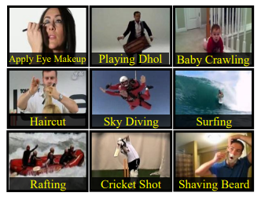
DATA EXPLORATION
Dataset Source : UCF - Center for Research in computer vision.
UCF101 included the 101 action classes like :
Baseball Pitch, Basketball Shooting, Bench Press, Biking, Billiards Shot, Clean and Jerk, Diving, Drumming, Fencing, Golf Swing, High Jump, Horse Race, Horse Riding and many more.
Divided into five types: Human-Object Interaction, Body-Motion Only, Human-Human Interaction, Playing Musical Instruments, Sport
We have 13320 video clips.

Slide 5
DATA PREPROCESSING
All the clippings have fixed Frame Rate 25 fps and Resolution 320×240
Some of the irrelevant action videos are removed.
Some are video as well as audio clips.
Summary of the UCF101 dataset is given in the below table :
Actions | 101
Clips | 13220
Min Clip Length | 1.06 sec
Max Clip Length | 71.04 sec
Frame Rate | 25 fps
Resolution | 320×240

Slide 6
LITERATURE SURVEY
Title | Author | Methodology | Outcome
Object and Human Action Recognition From Video Using Deep Learning Models (2019) | Padmeswari Nandiya Soentanto, Janson Hendryli, Dyah E. Herwindiati | Optical Flow Convolutional neural network | The model accuracy is 95.61%. Testing the model with the test data results in 56.41% in accuracy
Video Anomaly Detection and Classification for Human Activity Recognition (2017) | Shyma Zaidi, Jagadeesh B, Sudheesh K V | Object Tracking Action Recognition Classification of Actions | Normal activities are identified and labelled as “NORMAL ACTIVITY” with green label and Abnormal activities are with red label.
Human Activity Recognition (2020) | Ms. Shikha, Rohan Kumar, Shivam Aggarwal, Shrey Jain | A temporal spot in a film to generate training samples using sampling. A spatial position is choosen. | The trained model gave an accuracy of 79% on the kinetic dataset.

Slide 7
LITERATURE SURVEY (Contd…..)
Title | Author | Methodology | Outcome
Human Activity Recognition using Deep Neural Network with Contextual Information | Li Wei and Shishir K. Shah | Deep Neural Network | The accuracy was two low for two different datasets it’s accuracy was between 15 to 20%

Slide 8
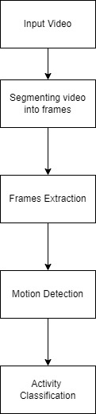
PROPOSED SOLUTION

Slide 9
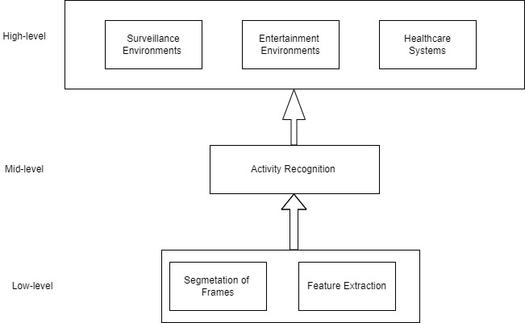
DETAILED DESIGN

Slide 10
METHODOLOGY & FRAMEWORK
Download and Extract the Dataset
Read and Preprocess the Dataset
Split the Data into Train and Test Set
Using a Model
Compile and Train the Model
Framework
Tensorflow

Slide 11
REFERENCES
[1]Padmeswari Nandiya Soentanto, Janson Hendryli, Dyah E. Herwindiati, Object and Human Action Recognition From Video Using Deep Learning Models, 2019 IEEE International Conference on Signals and Systems (ICSigSys)
[2] Shyma Zaidi, Jagadeesh B, Sudheesh K V, Video Anomaly Detection and Classification for Human Activity Recognition, International Conference on Current Trends in Computer, Electrical, Electronics and Communication (ICCTCEEC-2017)
https://www.crcv.ucf.edu/data/UCF101.php

Slide 12
THANK YOU

